Slide 1
COVID January 2020 to April 2021 DATA Analysis
By Raman Gill

Slide 2
Project goals:
Maximum covid deaths trend on monthly basis
Countries with highest covid infections
Countries with highest covid deaths
What percentage of population is vaccinated in various countries

Slide 3
Data source:
https://ourworldindata.org/covid-deaths
https://github.com/AlexTheAnalyst/PortfolioProjects/blob/main/CovidDeaths.xlsx
https://github.com/AlexTheAnalyst/PortfolioProjects/blob/main/CovidVaccinations.xlsx

Slide 4
Data Review and Cleaning:
Performed in excel and Power Query
Duplicates
Blank Cells
Merging of two separate datasets

Slide 5
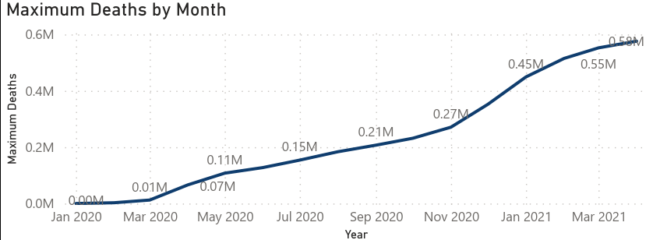
Maximum Covid deaths MONTHLY

Slide 6
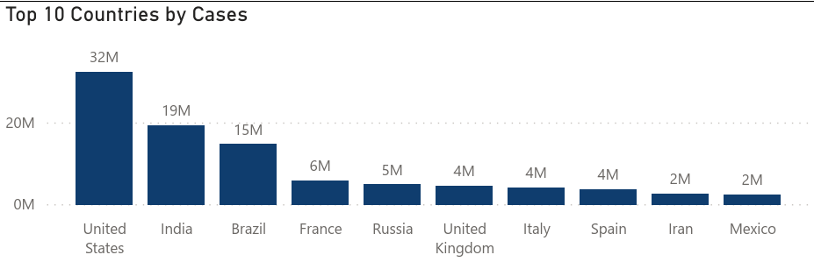
Countries with highest covid infections

Slide 7
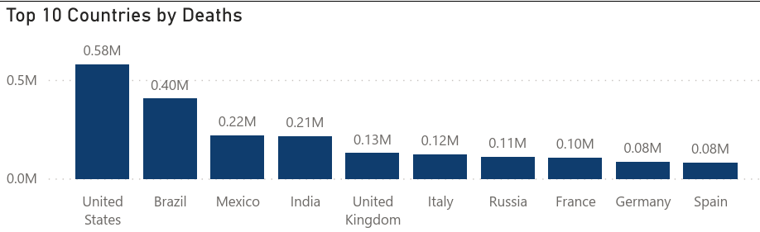
Countries with highest covid deaths

Slide 8
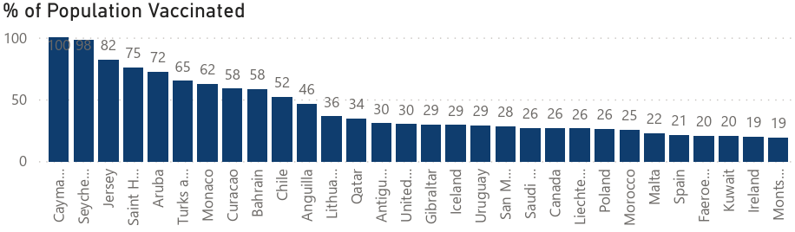
What percentage of population is vaccinated in various countries
Cayman Islands were leading with high percentage of population vaccinated.

